Slide 1
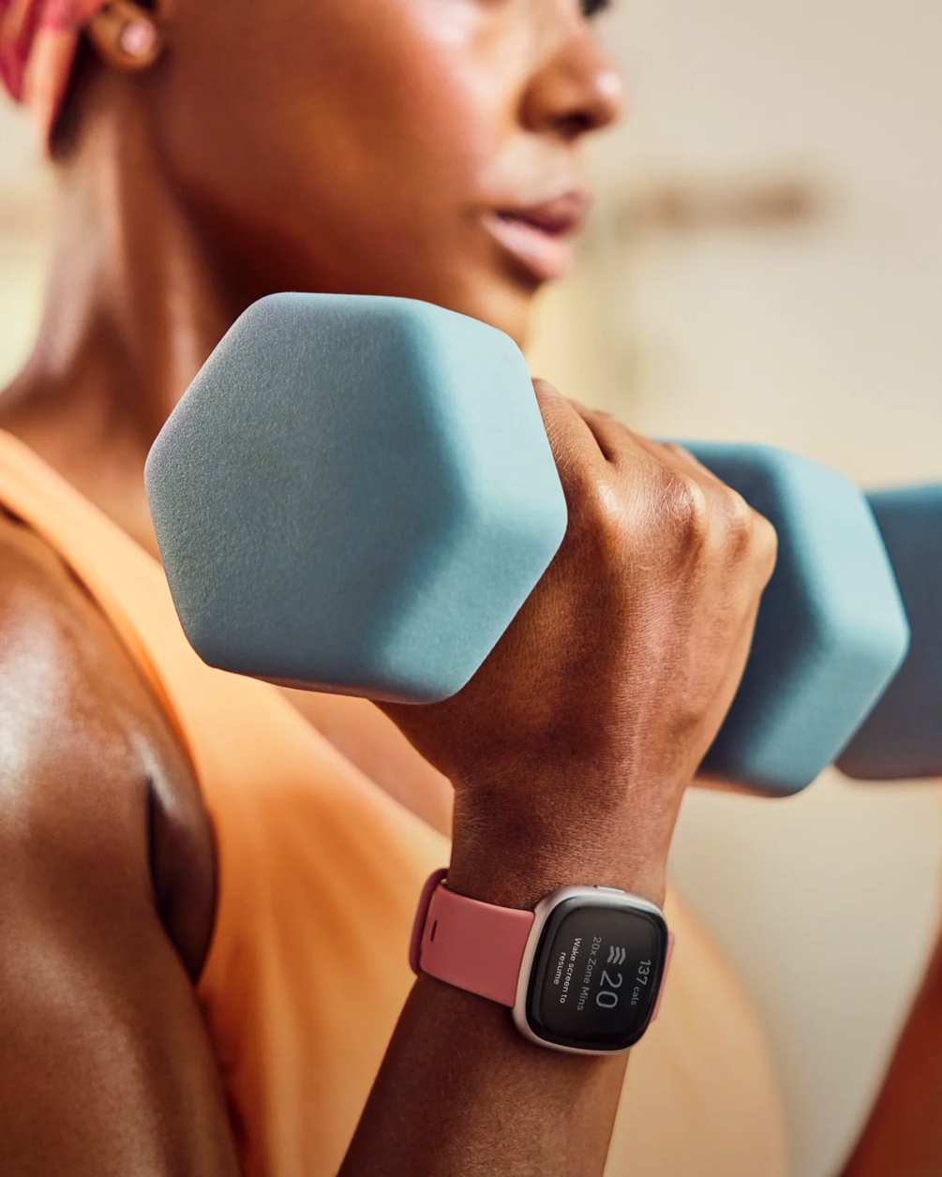

Let's be fit
for a bit!
A FITBIT USER'S DATA ANALYSIS & MACHINE LEARNING
BY CHUWONG KULRATTANARAK 6238044421
Presentation VDO: https://youtu.be/dotW7k7cN_8
Github: https://github.com/chuwong35122/2143488-Big-Data-and-Artificial-Intelligence-Project

Slide 2
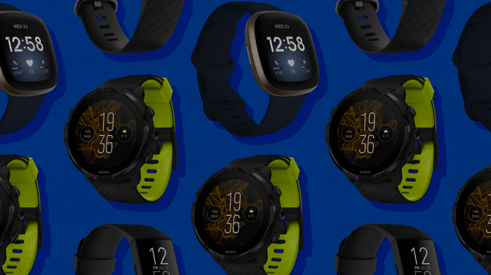
What's Fitbit?
Fitbit is a wearable fitness tracker and smartwatch that can track and monitor your steps taken, distance traveled, calories burned, health rate, sleep patterns, breathing, etc.

Slide 3
Questions
Can we predict users' sleep quality from their daily activity recorded by the device?
Can we use a regression model to predict a person's calories used from their daily activity?

Slide 4
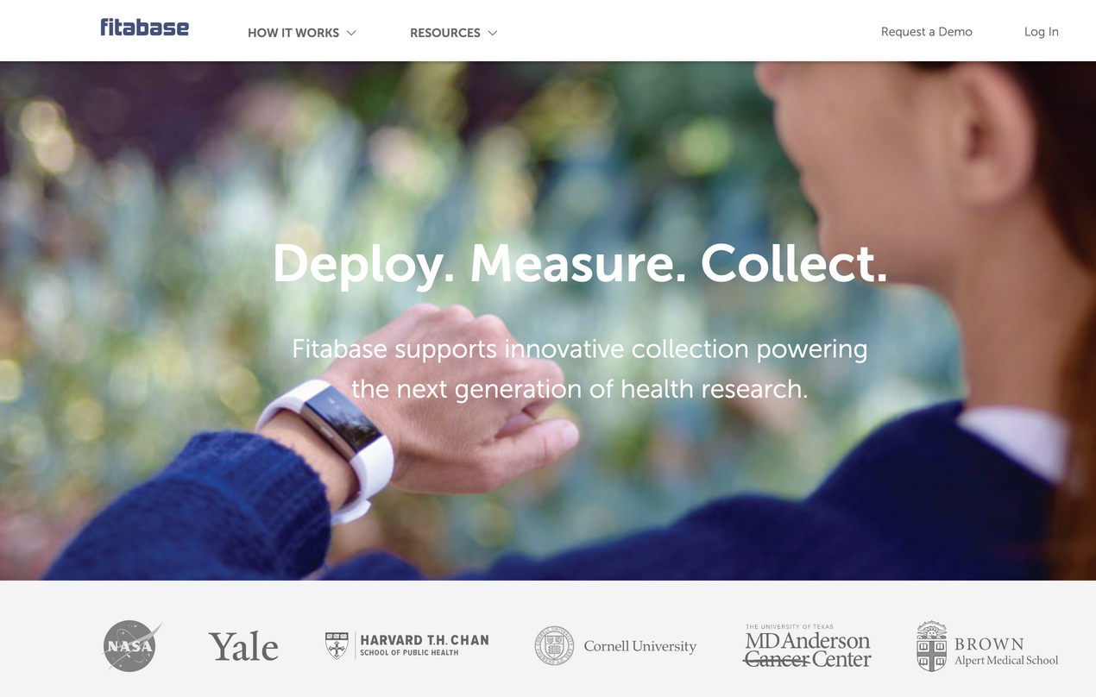
Data sources
https://www.fitabase.com/resources/knowledge-base/exporting-data/example-data-sets/
Data exported from Fitabase (a data collecting platform)
Contains much more daily data
Data is uncleaned
New data can be accessed by its API with its paid plan.
Original data contains 7,410 rows
Click Me! Official Data Dictionary

Slide 5
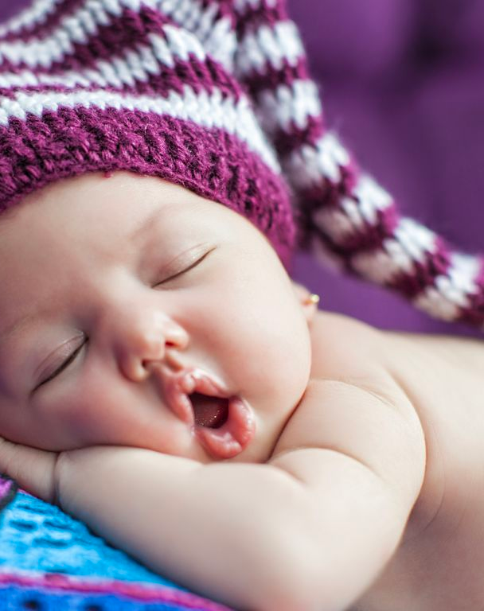
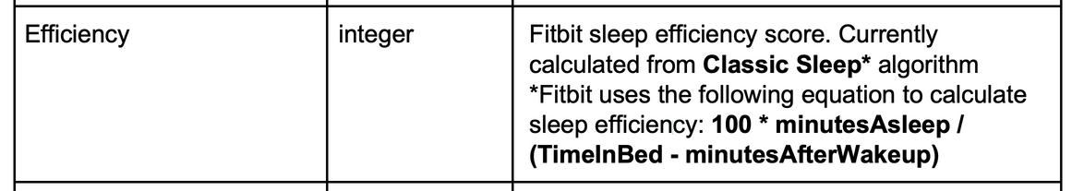
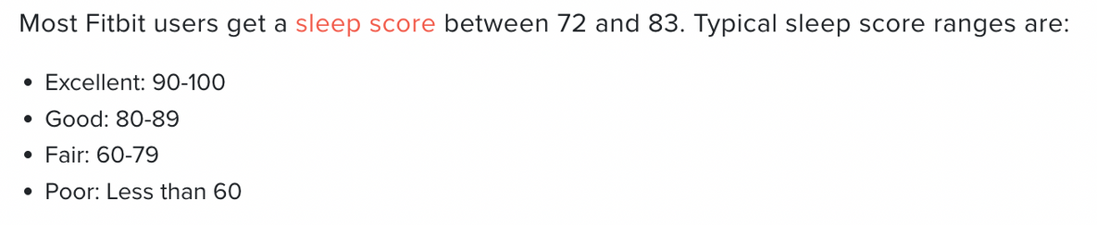
Predicting Good Sleep Quality
Fitbit has defined its own sleep score for their user using sleep duration, deep sleep quality duration, and how relaxed the user is during sleep.
In the sleep data, there is a column named 'efficiency'

Slide 6
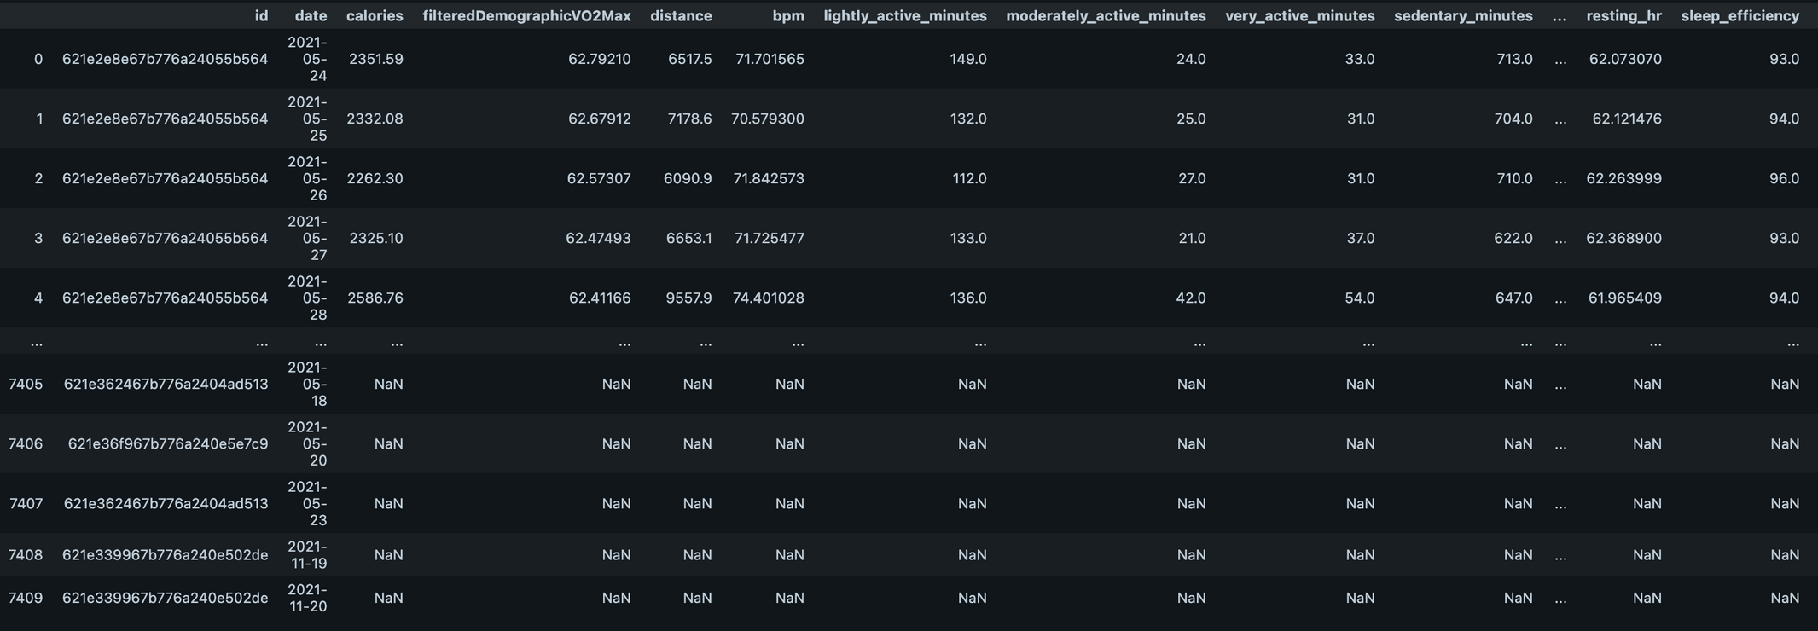
Data Exploration & Preprocessing

Slide 7
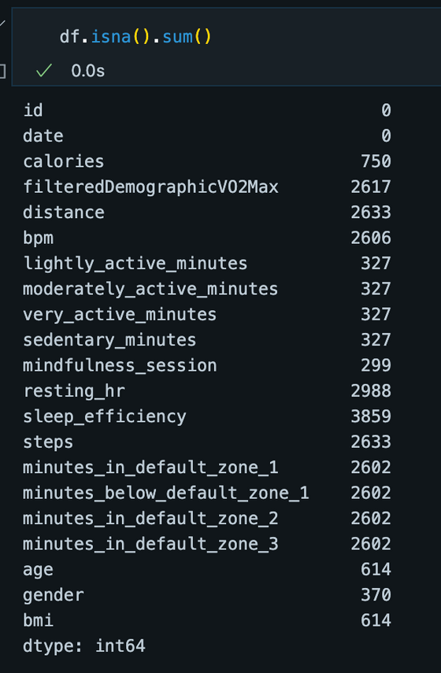
Data Exploration & Preprocessing
Filled in with column's median & drop the others
There are 3,023 rows left

Slide 8
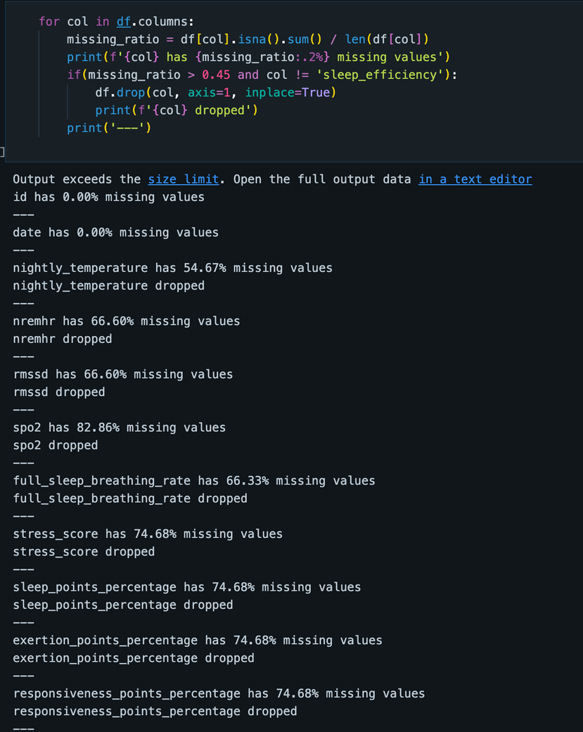
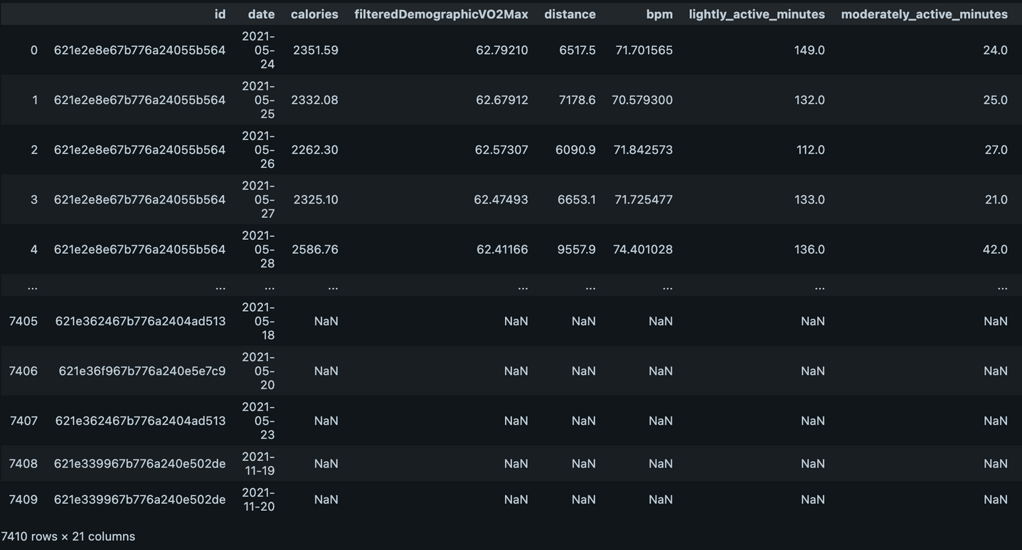
Data Exploration & Preprocessing

Slide 9
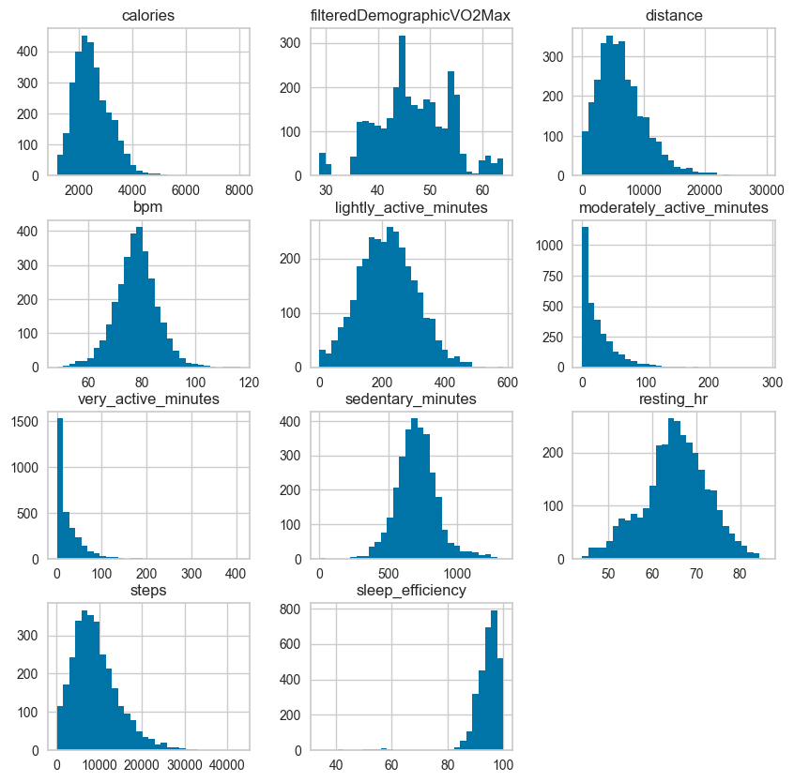
Data Exploration & Preprocessing

Slide 10
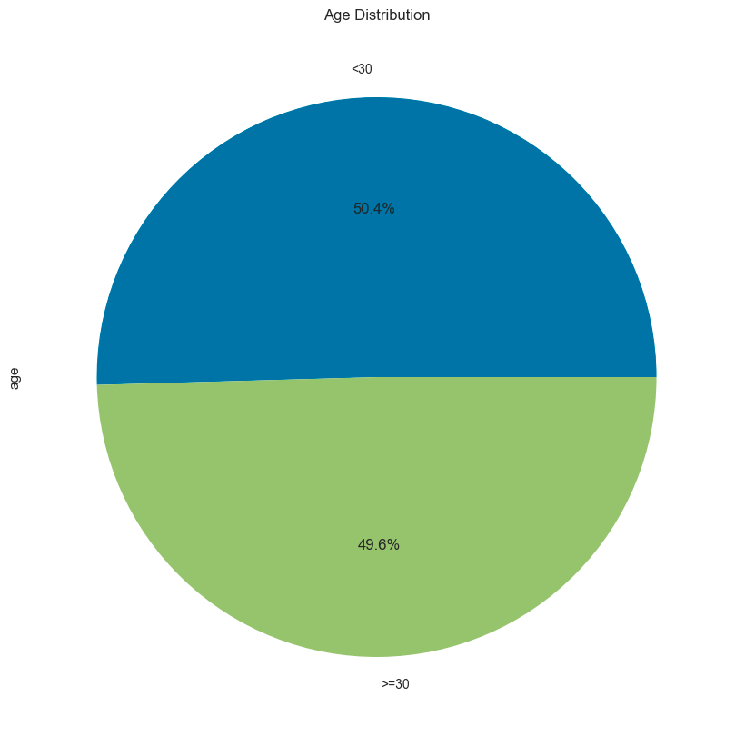
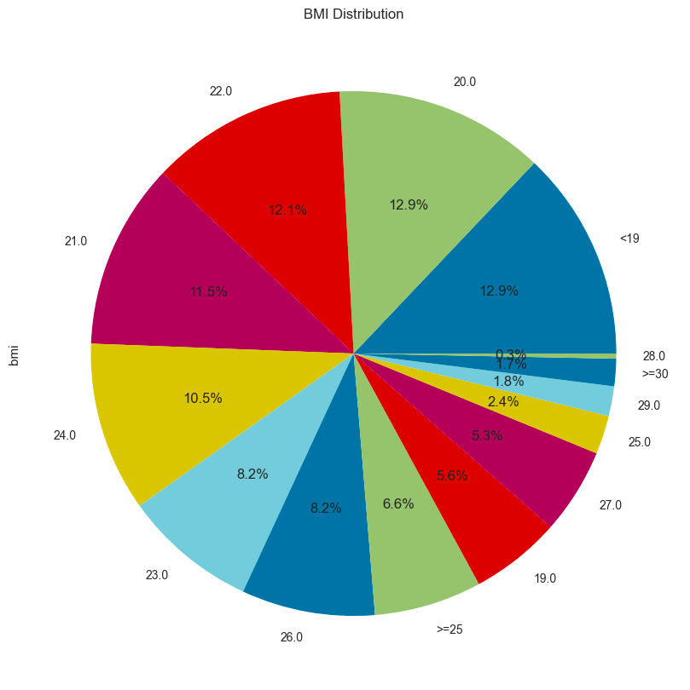
Data Exploration & Preprocessing

Slide 11
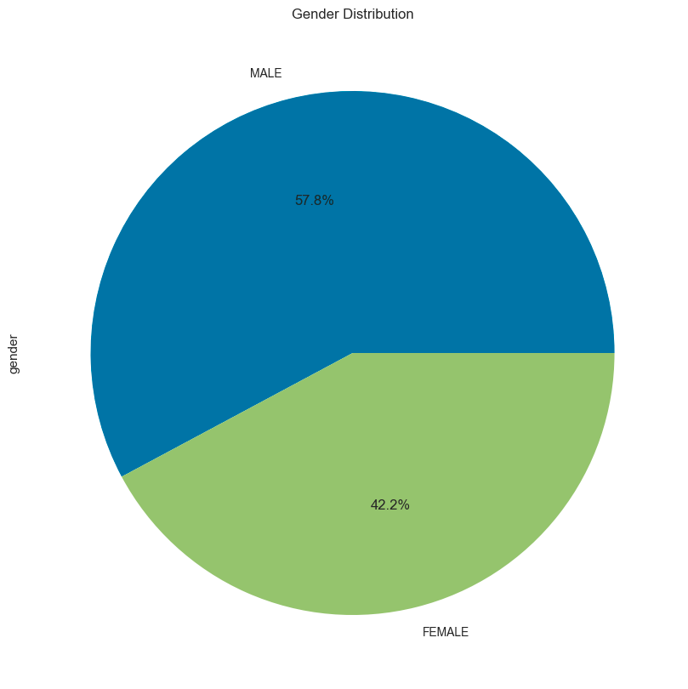
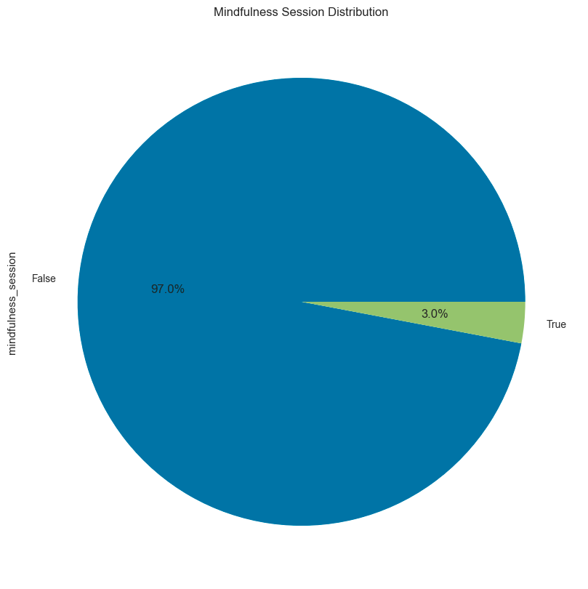
Data Exploration & Preprocessing

Slide 12
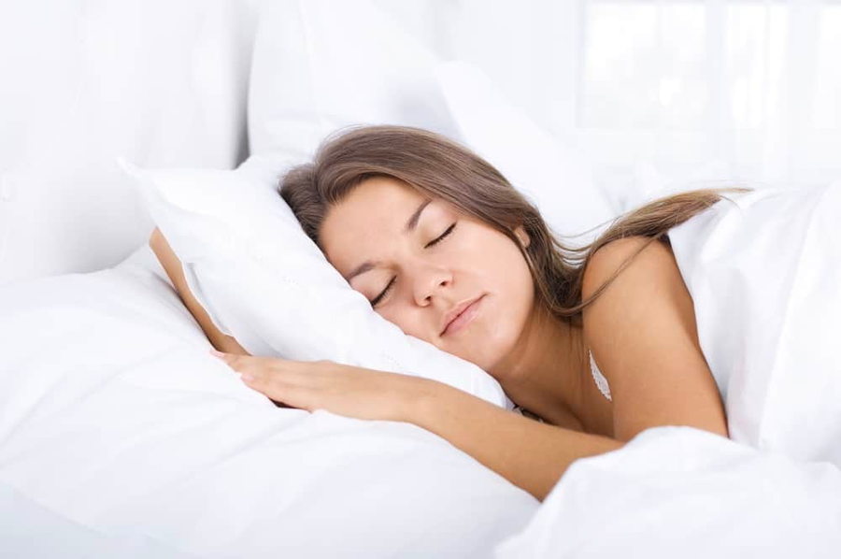
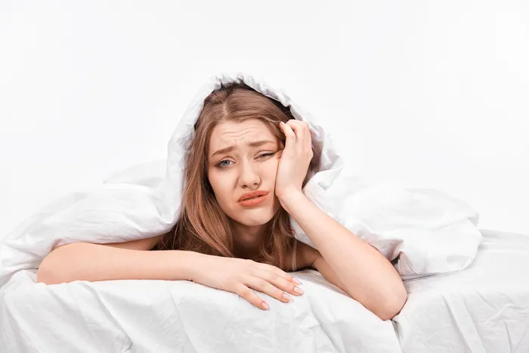
Data Exploration & Preprocessing
excellent/good/fair/poor

Slide 13
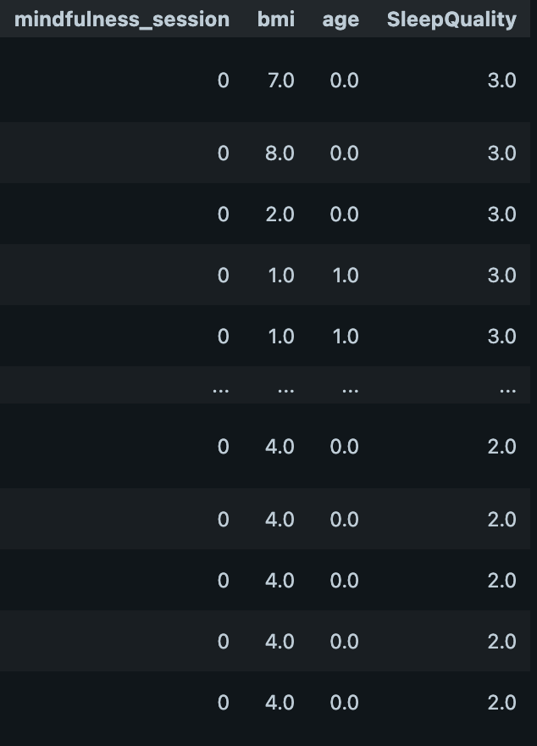
Data Exploration & Preprocessing

Slide 14
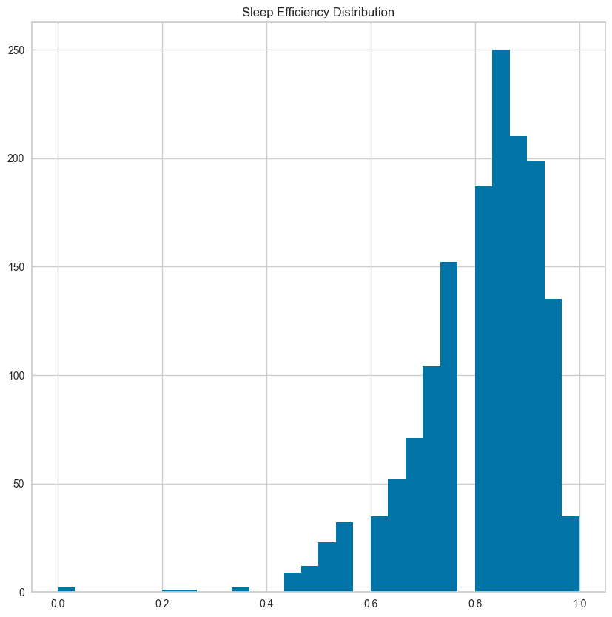
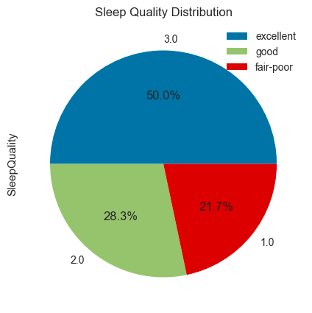
Data Exploration & Preprocessing
The sampled data includes
140 rows of class 1
878 rows of class 2
1,018 rows of class 3
After sampling

Slide 15
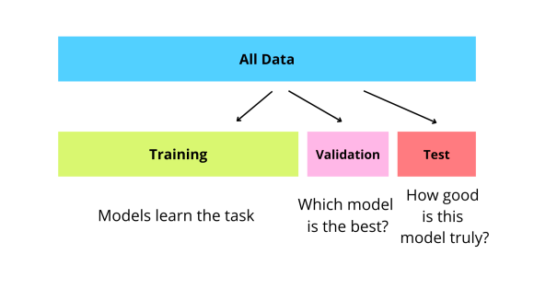
Data Exploration & Preprocessing

Slide 16
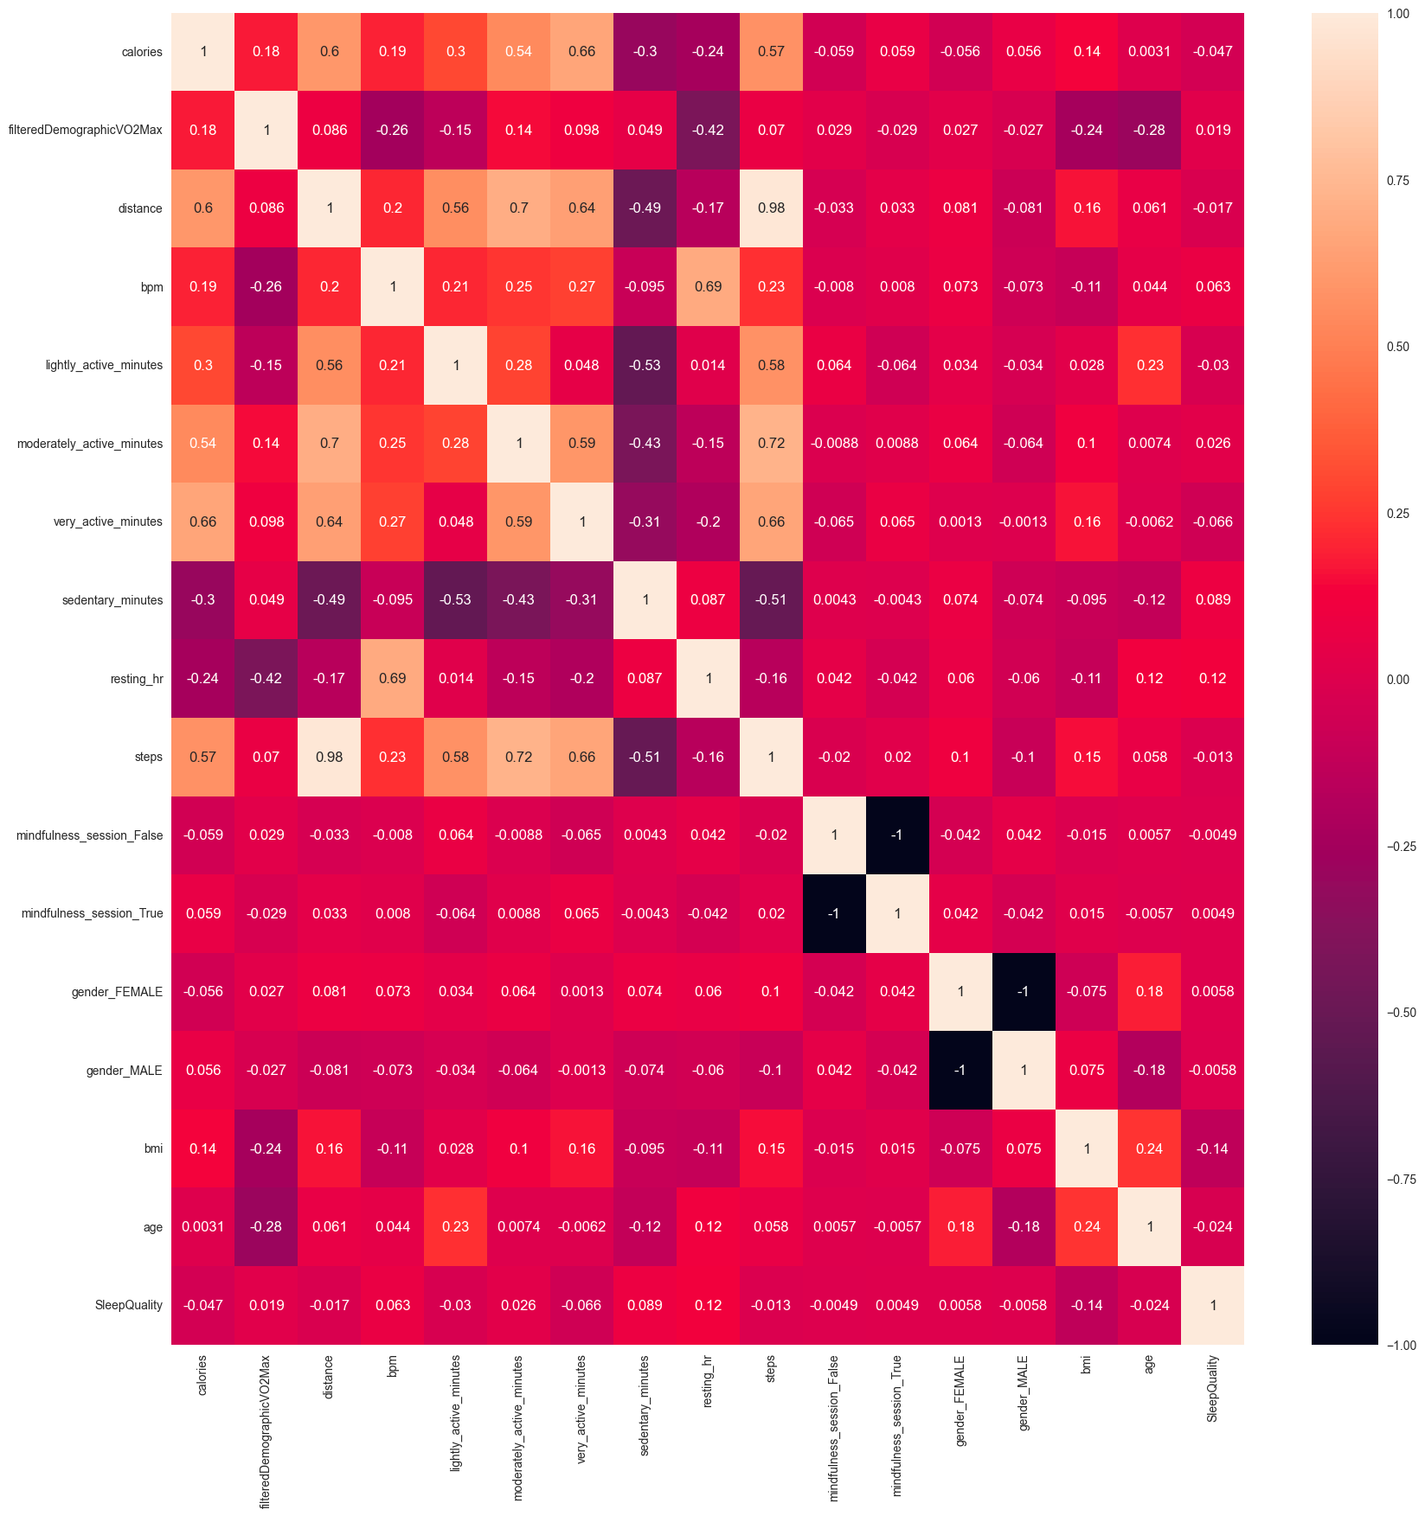

Model Evaluation
Logistic Regression

Slide 17
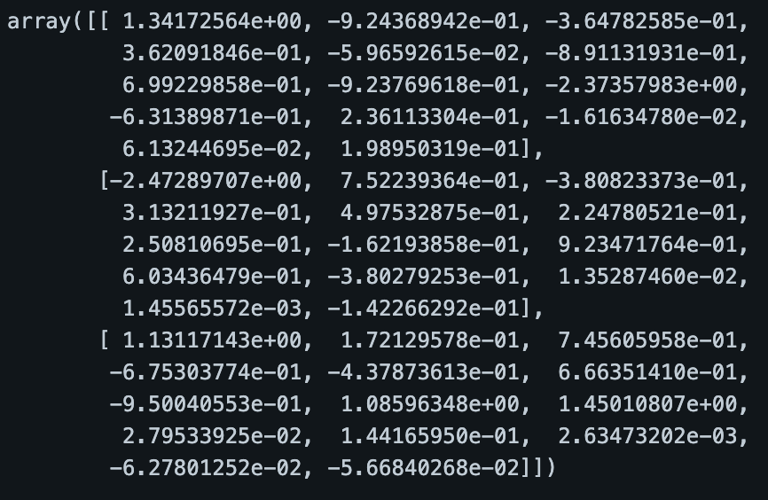
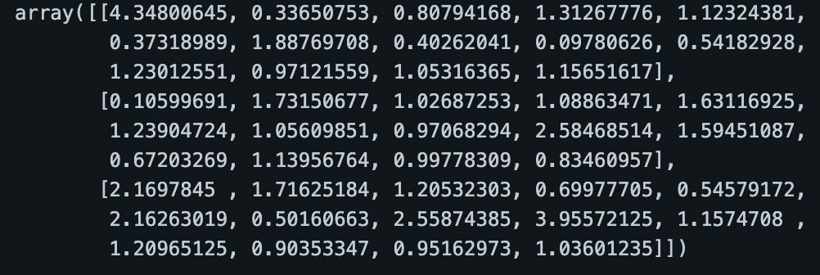
Model Evaluation
Logistic Regression
Intercepts
Odd Ratios
Coefficients

Slide 18
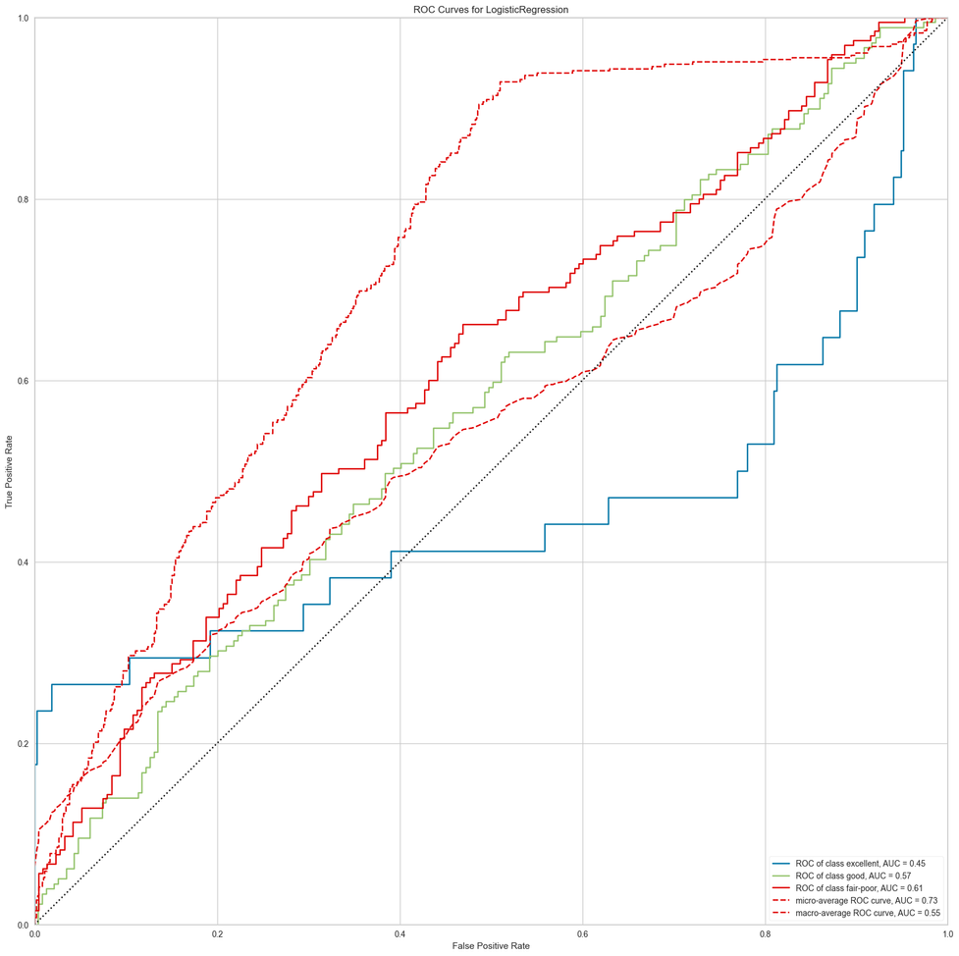
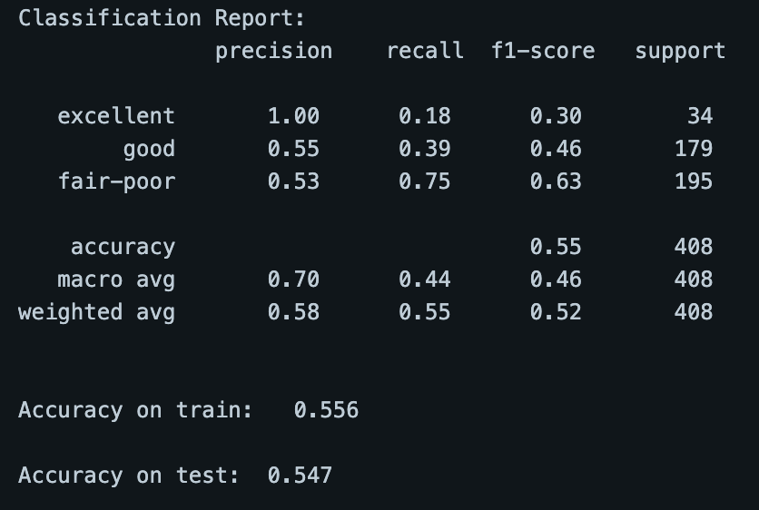
Model Evaluation
Logistic Regression

Slide 19
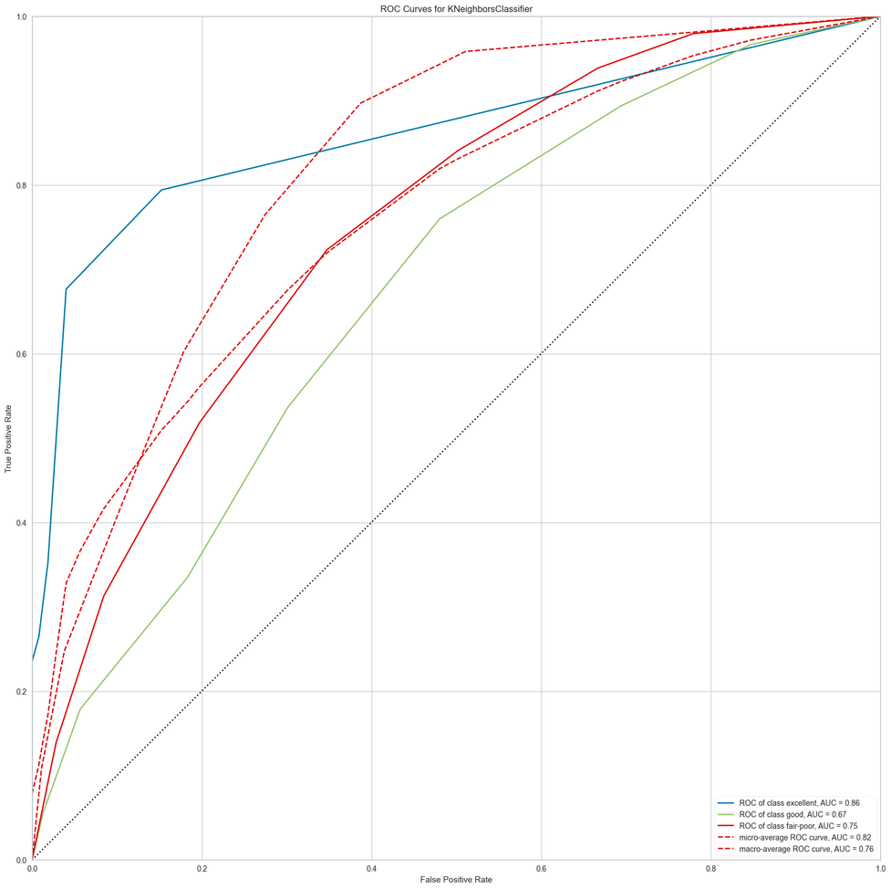
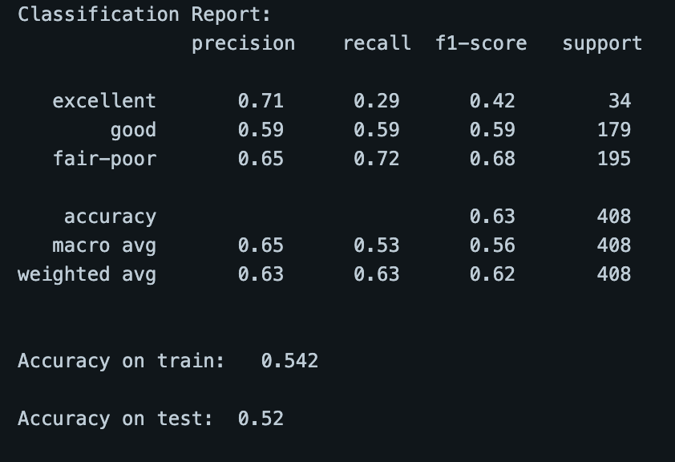
Model Evaluation
KNN (k=7)

Slide 20
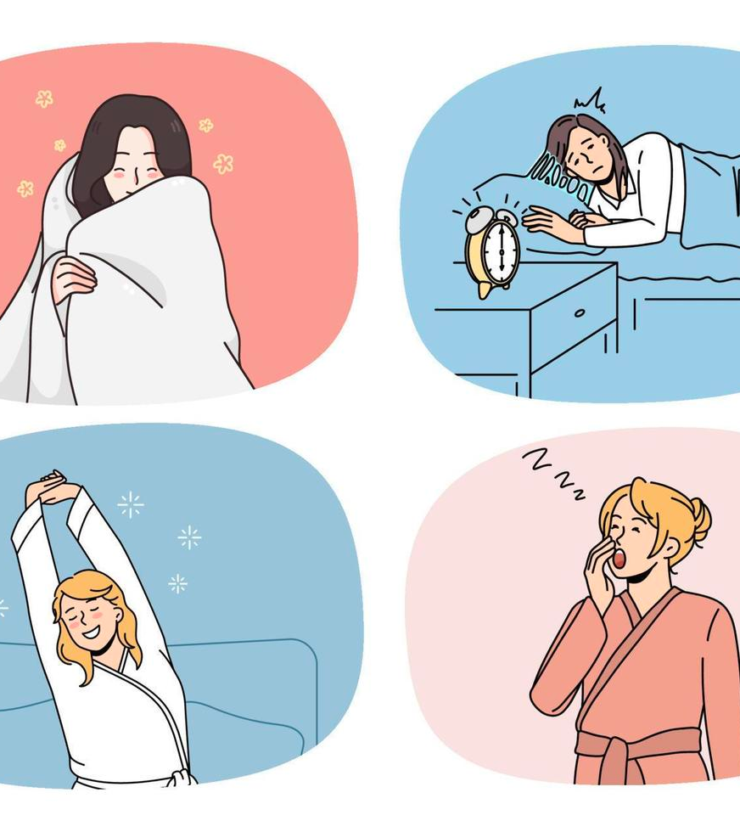
Q1. Conclusion
Prediction of sleep quality is possible from daily activity.
We want to focus on precision
Both models yield different classification approaches.
Logistic regression is better at detecting Excellent sleepers.
KNN is better at detecting the overall classes.
Recommendation
Retrieve data with an equally distributed classes and with more data.

Slide 21
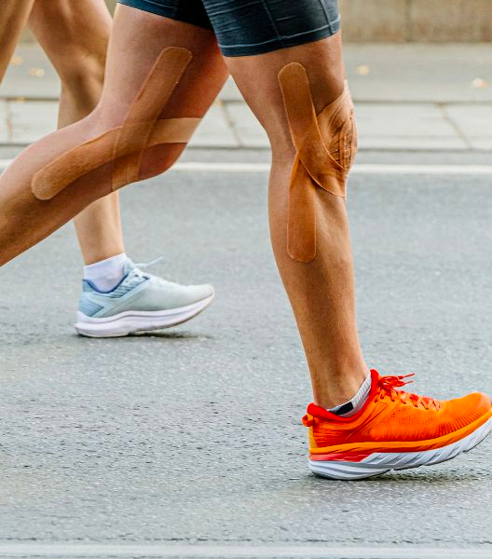
Predicting Calories
Calories = energy used by the body
Gender, Age, Body Physique, and daily activities affect daily calories.
Does this mean we can predict calories if we know these values?

Slide 22
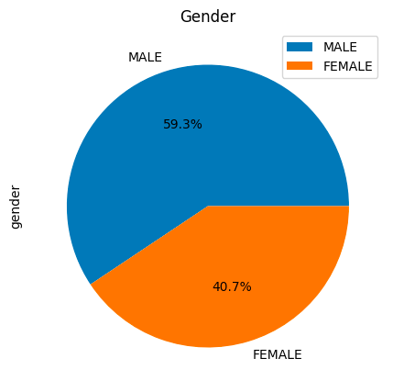
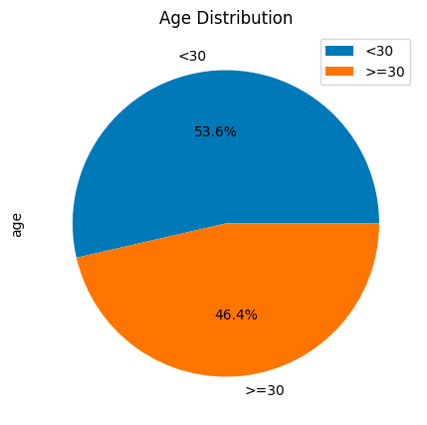
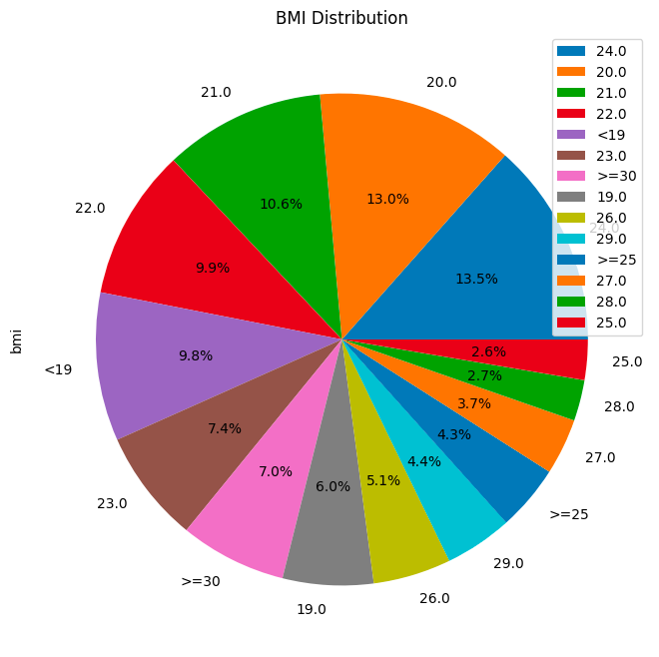
Predicting Daily Calories

Slide 23
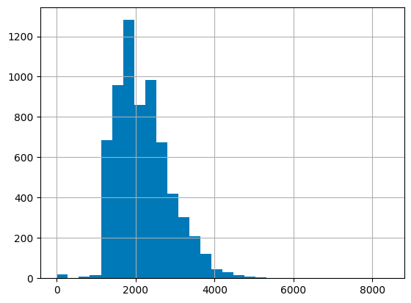
Predicting Daily Calories

Slide 24
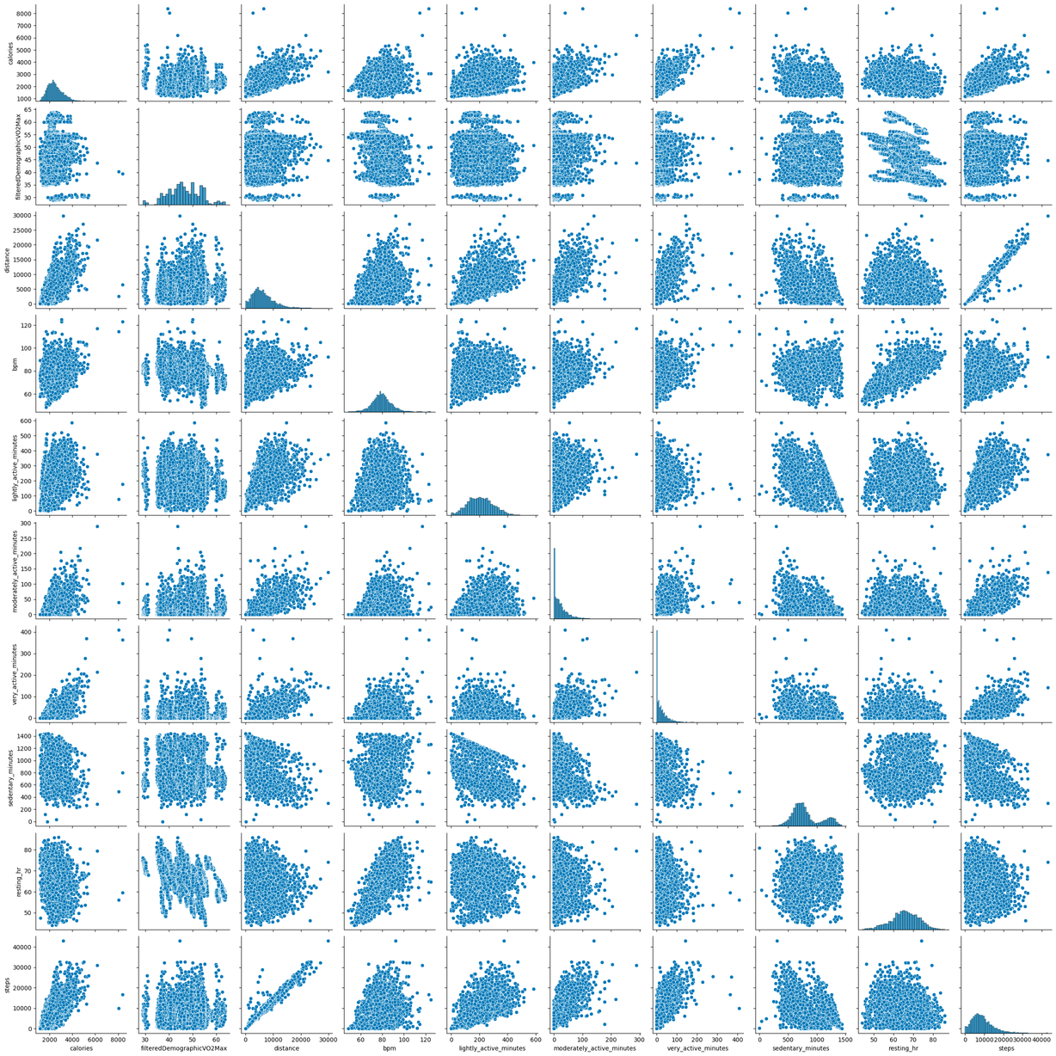
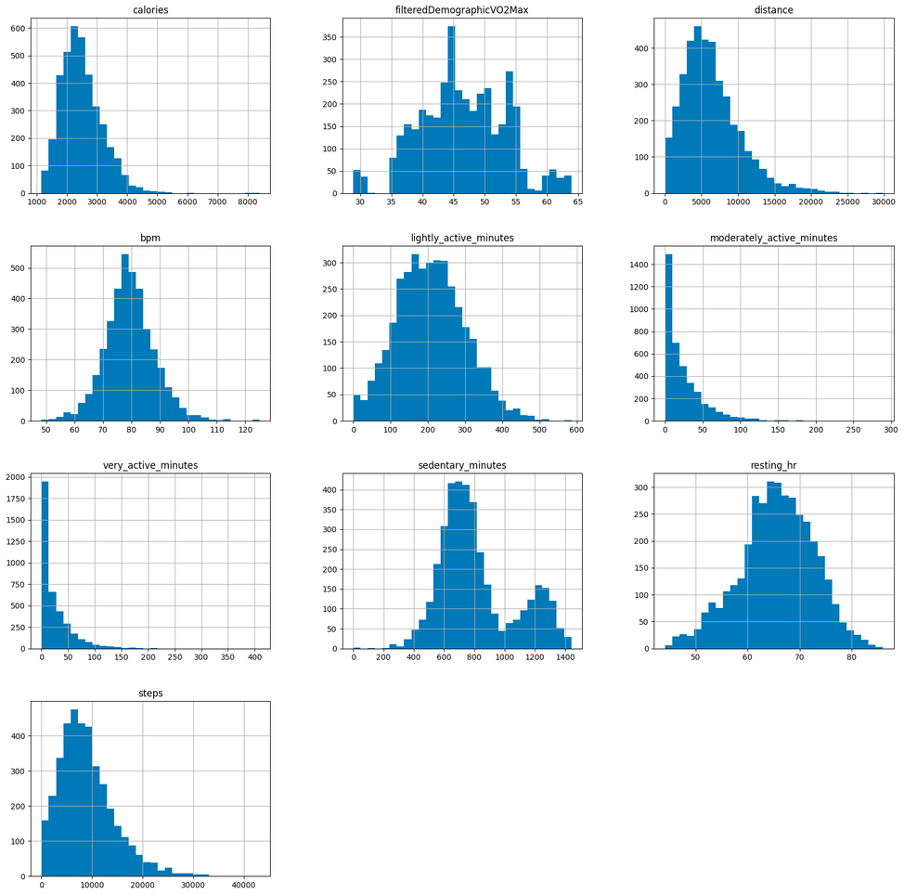
Predicting Daily Calories

Slide 25
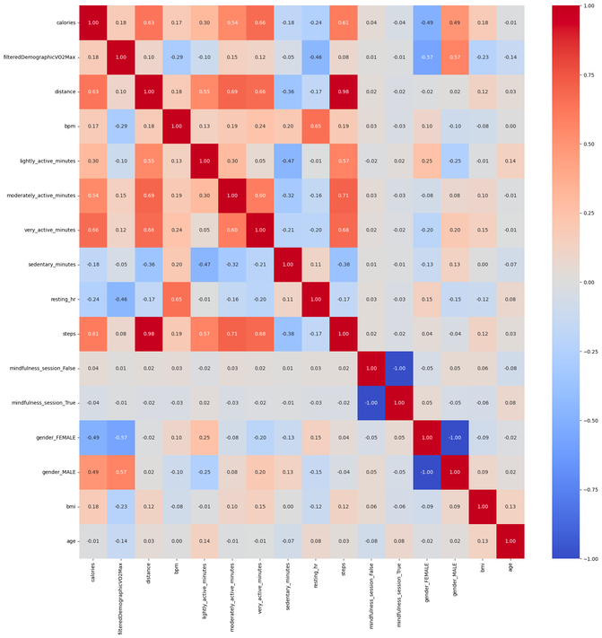
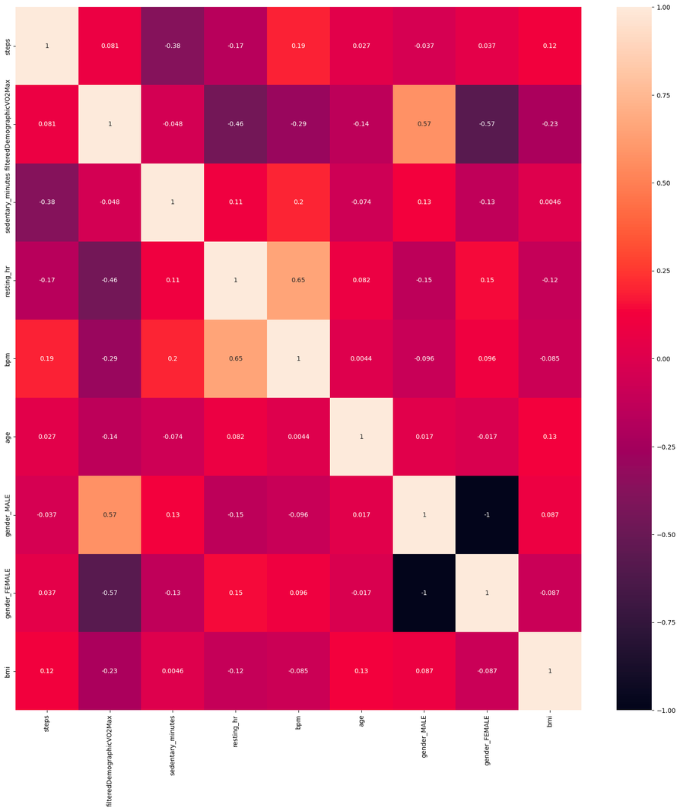
Predicting Daily Calories
Selected Features
steps
filteredDemographicVO2Max
sedentary_minutes
resting_hr
bpm
age
gender_MALE
gender_FEMALE
bmi

Slide 26
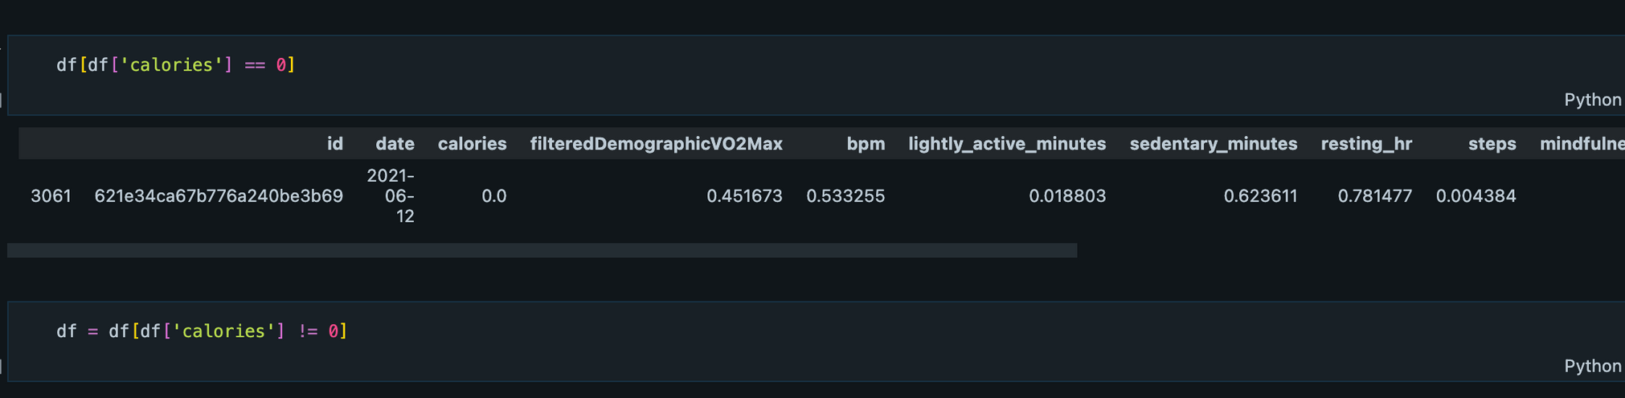
Predicting Daily Calories

Slide 27
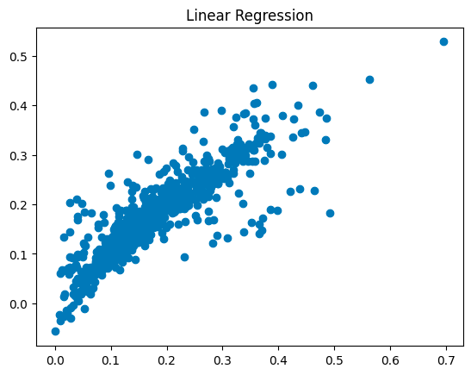
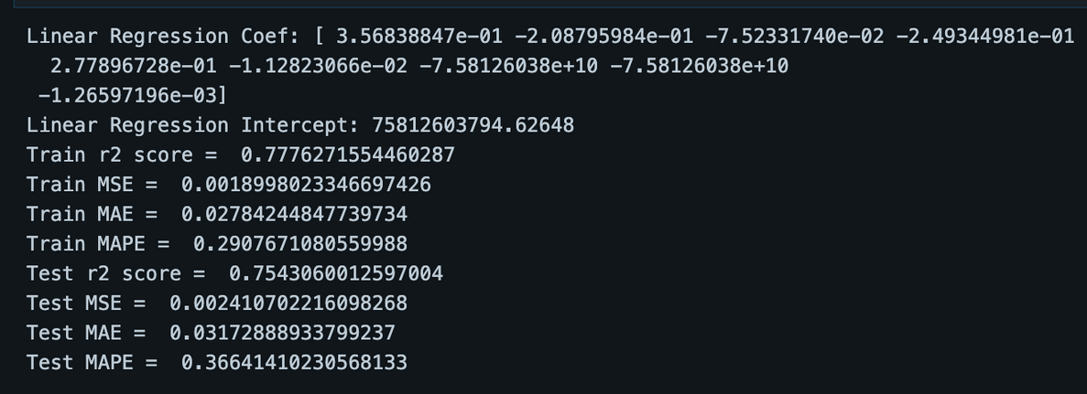

Slide 28
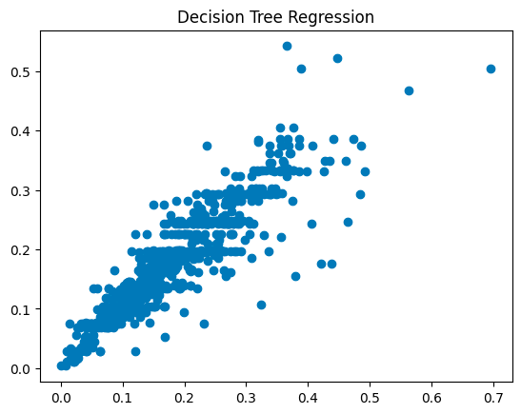
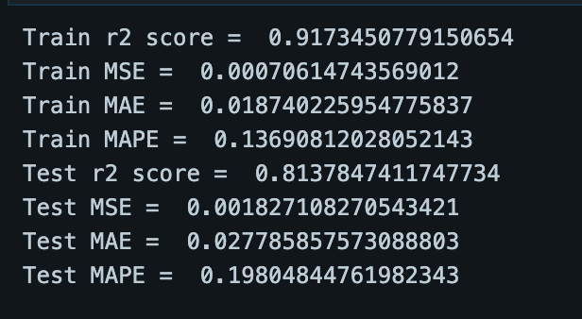

Slide 29
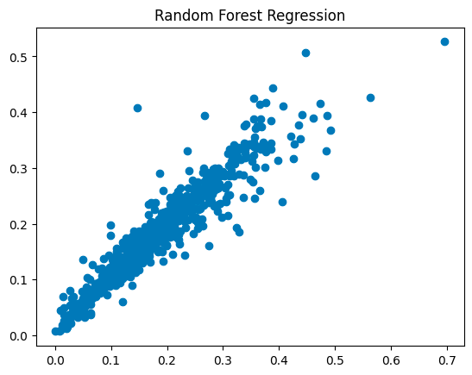
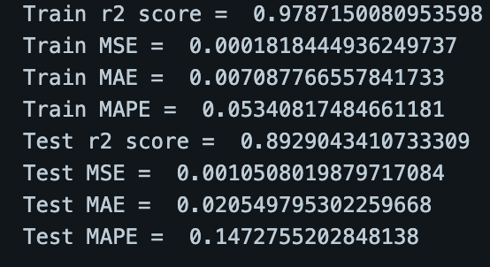

Slide 30
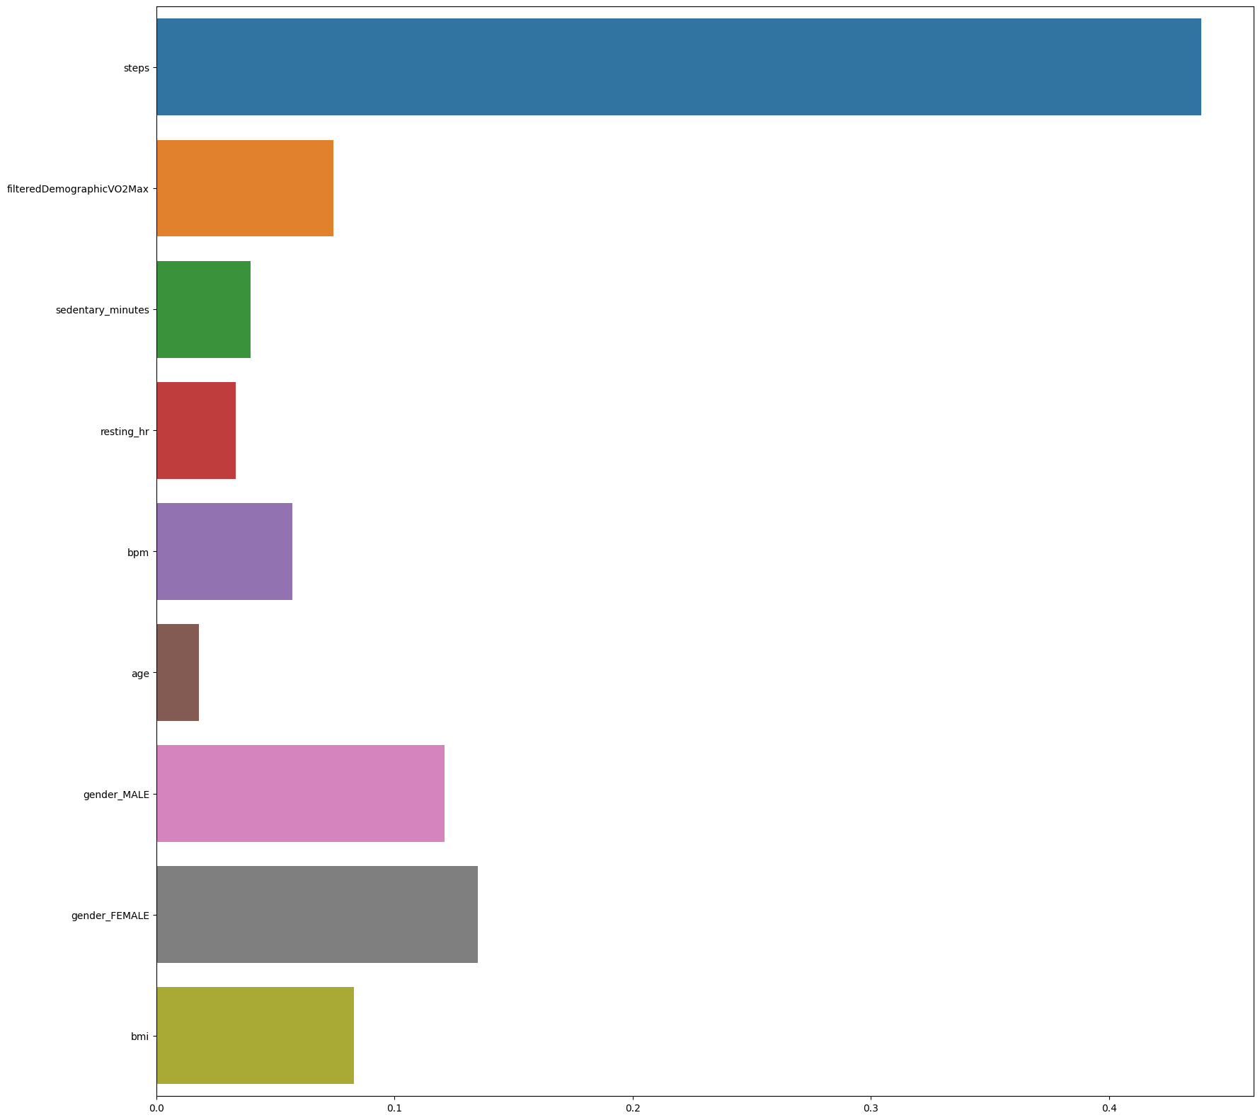
Random Forest Regression’s
Feature Importances
Steps feature has the most score, indicating that it influences the model the most.
Genders and body type (as indicated in BMI) also influence the model.
Thus, the research on features that may influence daily calories used can be confirmed.

Slide 31
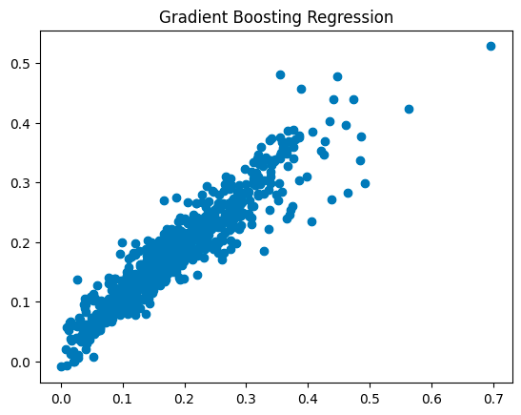
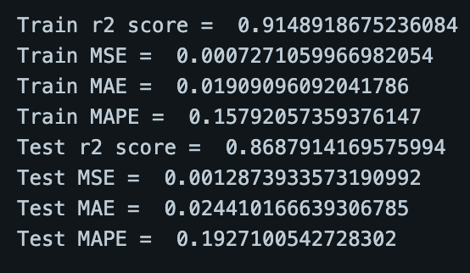

Slide 32
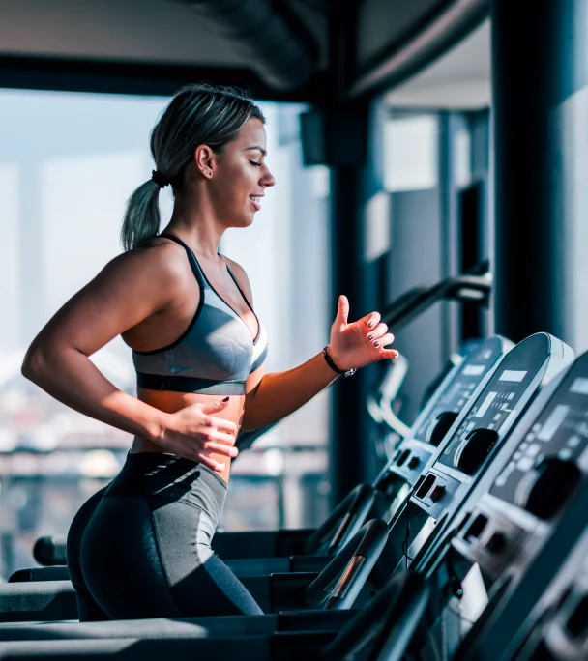
Q2. Conclusion
Prediction of daily calories burned is possible with a regression model.
From the experiment, Random Forest Regression yields the best r-square.
To improve the model, more data could be collected and categorized such as age range, person race, body type, etc.

